Slide 1
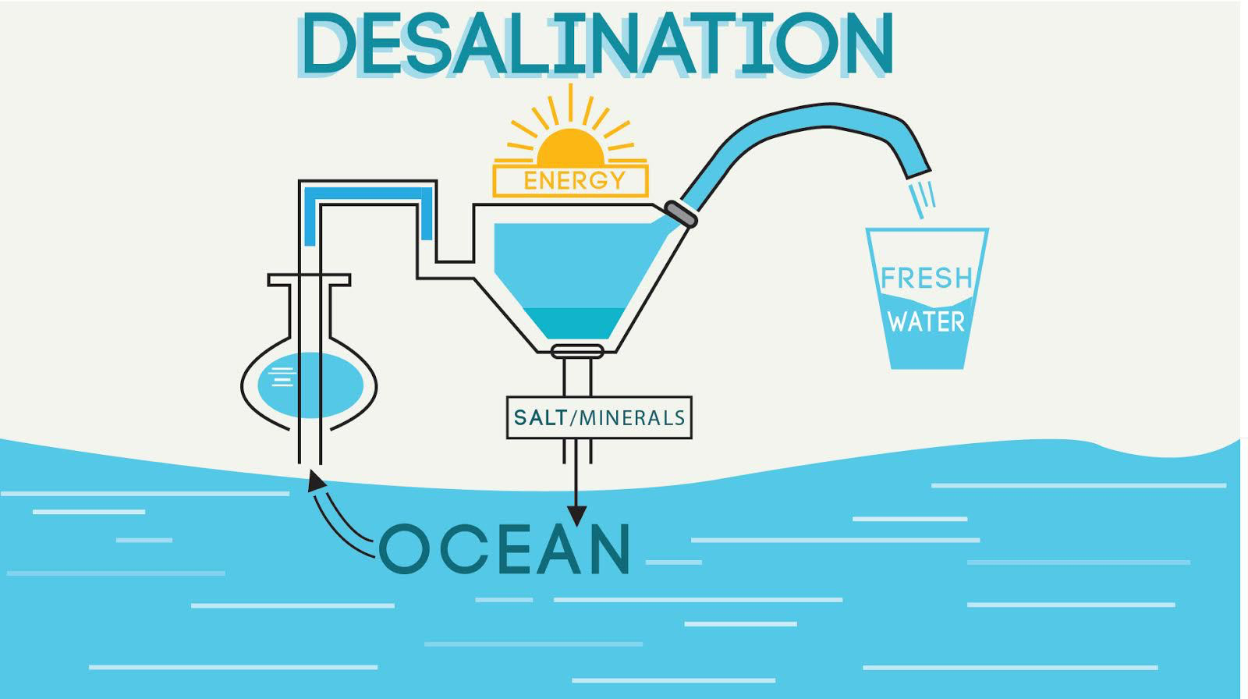
Andrew Crenwelge

Slide 2
Overview
Global water supply challenges
How desalination addresses water shortages
Desalination process
Explanation of various methods
Comparison of methods
Economic analysis
Conclusion

Slide 3
Global Water Supply Challenges

Slide 4
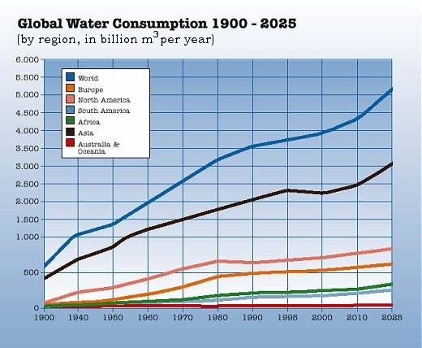
Global Water Supply Challenges

Slide 5
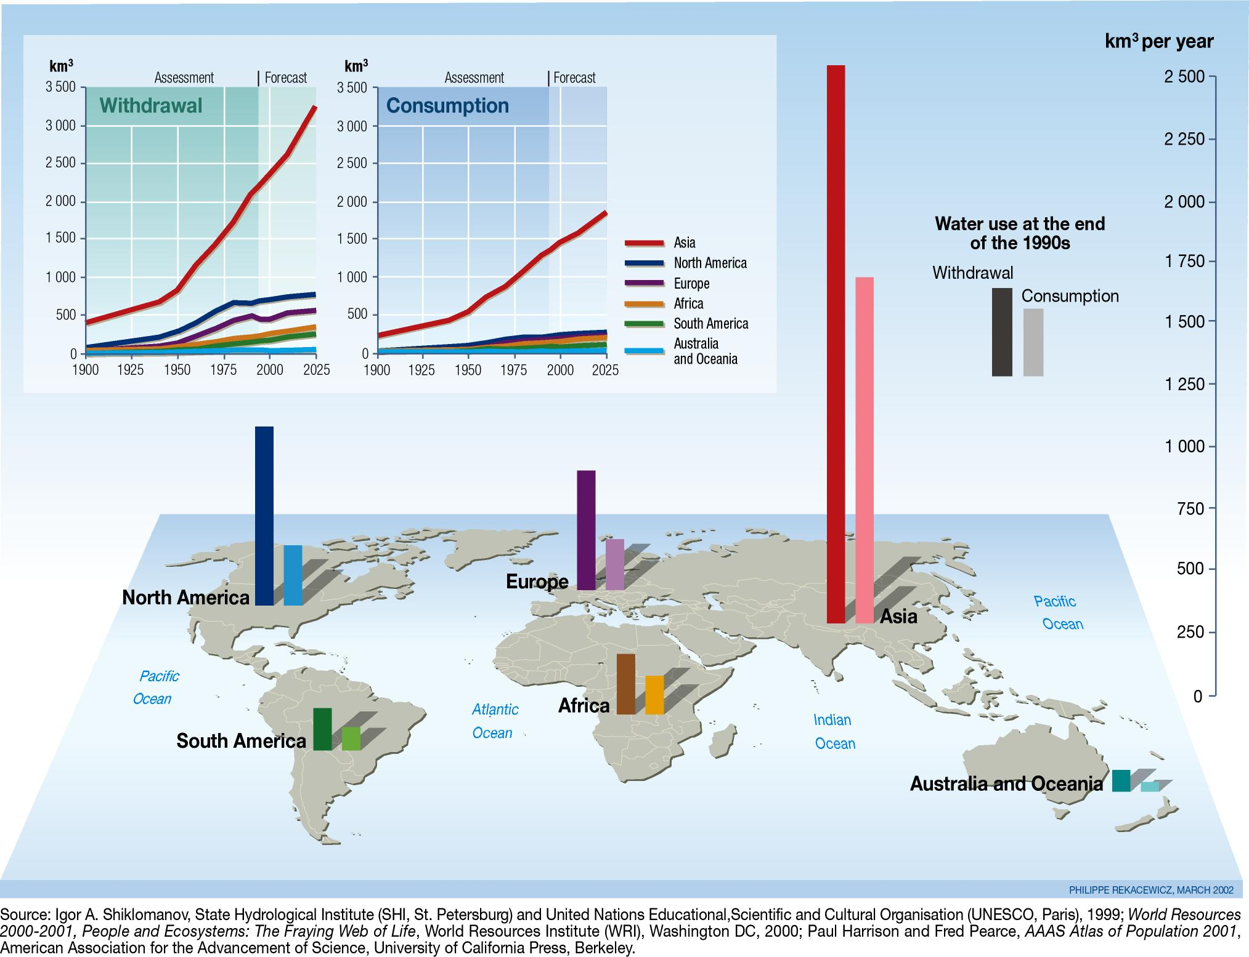
Global Water Supply Withdrawal and Consumption

Slide 6
Global Water Supply Challenges
Earth’s freshwater supplies are only 2.5% of its total water while saline water is 97.5%, mainly concentrated in the oceans
Earth’s oceans contain, on average, about 3.5% salt by mass
~35g of salt per 1kg saltwater
Water containing between 0.035% and 0.1% salt is called marginal water, because it might still have harmful effects to animals and humans
Freshwater is defined as containing less than 1% of ocean salt concentration, so about 0.035%
 | Salt Concentration (wt%)
Saline water | > 0.1%
Marginal water | 0.035% - 0.1%
Freshwater | < 0.035%

Slide 7
How Can Desalination Help?
Salt water is much more abundant than fresh water
Fresh water supplies are being depleted faster than they can be replenished
Water scarcity and shortages can be eliminated if we can find a way to economically transform salt water to fresh water
The engineering challenge is to convert brine at 3.5% salt to potable water at < 0.035%
Conversion of salt water to fresh water is called desalination

Slide 8
Desalination Process
Many methods:
Distillation
Mult-stage flash distillation (MSF)
Multiple-Effect Distillation (MED)
Mechanical Vapor Compression (MVC)
Ion exchange
Membrane processes
Electrodialysis reversal (EDR)
Reverse osmosis (RO)
Nanofiltration (NF)
Membrane Distillation (MD)
Forward Osmosis (FO)
Geothermal desalination
Solar desalination

Slide 9
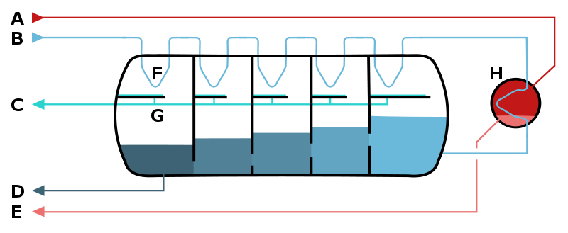
Multi-stage Flash Distillation (MSF)
Distills sea water by flash evaporation
Multiple stages utilize essentially counter-current heat exchangers
This method provides 60% of world’s desalinated water
Schematic of a multistage flash desalinator
A – steam in
B – seawater in
C – potable water out
D – waste out
E – steam out
F – heat exchange
G – condensation collection
H – brine heater

Slide 10
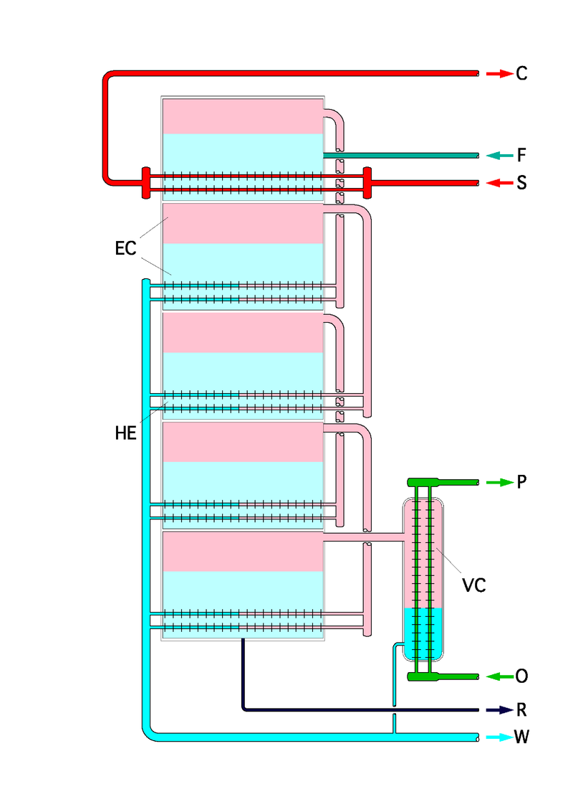
Multi-Effect Distillation (MED)
Multiple stages where the water is heated by steam in tubes and the evaporated water flows into tubes of the next stage
Essentially reuses energy from previous stages
Can increase the number and length of the tubes (higher efficiency), at the expense of increased installation cost
Advantages:
Low energy consumption compared to other thermal processes
Does not need pre-treatment of sea water and tolerates variations in sea water conditions
Highly reliable and simple to operate
Low maintenance cost
F - feed water in
S - heating steam in
C - heating steam out
W - Fresh water out
R - brine out
O - coolant in
P - coolant out
VC - last-stage cooler

Slide 11
Mechanical Vapor Compression (MVC)
One way to achieve MVC is vacuum vapor compression, which evaporates the saline water at sub-atmospheric pressures
This process requires less heat to be supplied (due to a lower boiling point at lower pressures)
“Waste” heat can be minimized

Slide 12
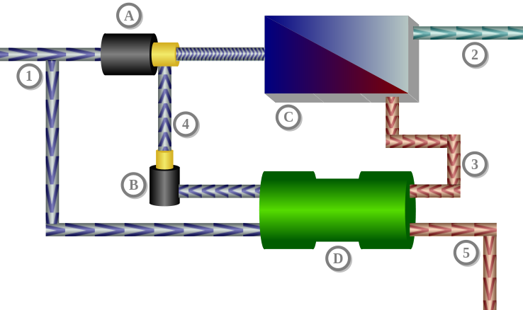
Reverse Osmosis
Reverse osmosis technology uses pressure gradients across semi-permeable membranes to filter out salts and other particles
To be “selective” or semi-permeable, the membrane should not allow large molecules or ions through the pores, but should allow smaller components of the solution (such as solvent molecules) to pass freely
Schematics of a reverse osmosis desalination system using a pressure exchanger:
1: Sea water inflow
2: Fresh water flow
3: Concentrate flow
4: Sea water flow
5: Concentrate (drain)
A: Pump flow
B: Circulation pump
C: Osmosis unit with membrane
D: Pressure exchanger

Slide 13
Wave-powered Deep Sea Reverse Osmosis
Current Method
Proposed Method
Dashtpour and Al-Zubaidy have researched a new method using deep sea hydrostatic pressure in conjunction with wave energy
This process reduces energy costs because only the produced fresh water is pumped to the surface
A typical seawater reverse osmosis plant, 3 to 10 kWh of electricity is required to produce one cubic meter of freshwater; in this approach, specific energy consumption can be reduced to 2.46 kWh
Pretreatment
Seawater
Freshwater
Post Treatment
Storage Tank
Reverse Osmosis Process
High Pressure Pumps
Low head circulating pumps
Course Filtration
Seawater
Freshwater
Post Treatment
Storage Tank
Reverse Osmosis Process
High Pressure Contaminated Concentrated Seawater
Low Pressure Uncontaminated Concentrated Seawater

Slide 14
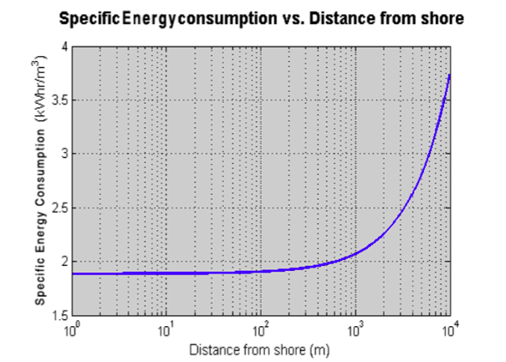
Wave-powered Deep Sea Reverse Osmosis
The research has shown that energy costs are higher at distances further from the shore
However, specific energy consumption for process units located under 10km from shore are less than typical seawater reverse osmosis plants

Slide 15
Comparison of Desalination Methods by Energy Consumption
 | Multi-stage Flash | Multi-Effect Distillation | Mechanical Vapor Compression | Reverse Osmosis
Electrical energy (kWh/m³) | 4-6 | 1.5–2.5 | 7-12 | 3-5.5
Thermal energy (kWh/m³) | 50-110 | 60-110 | None | None
Electrical equivalent of thermal energy (kWh/m³) | 9.5-19.5 | 5-8.5 | None | None
Total equivalent electrical energy (kWh/m³) | 13.5-25.5 | 6.5–11 | 7–12 | 3–5.5
Note: Transport of local freshwater supplies requires ~0.2 kWh/m³

Slide 16
Economic Analysis
Monetary costs of desalination are typically greater than options for retrieving and transporting local freshwater (rivers, ground water)
However, desalination costs are competitive when compared with transportation of freshwater over long distances
Major component of desalination cost is energy prices, which can fluctuate

Slide 17
Conclusion
Desalination can provide access to the vast majority of the world’s water supply and help to deal with increasing demand in the future
Reverse osmosis is currently the most energy efficient and cost-effective process
Deep sea applications could be attractive in niche markets near coasts where local freshwater is unavailable

Slide 18
References
Dashtpour, Reza & Sarim N. Al-Zubaidy. Energy Efficient Reverse Osmosis Process. International Journal of Environmental Science and Development. Vol. 3 No. 4. Published: August 2012. Web
Energy Requirements of Desalination Process. Encyclopedia of Desalination and Water Resources. Web.
Vital Water Graphics: An Overview of the World’s Fresh and Marine Waters – 2nd Edition - 2008. United Nations Environmental Programme (UNEP).
Introduction of Nuclear Desalination. IAEA Technical Report Series No. 400. IAEA. (2000).

Slide 19
Questions?

